Slide 1
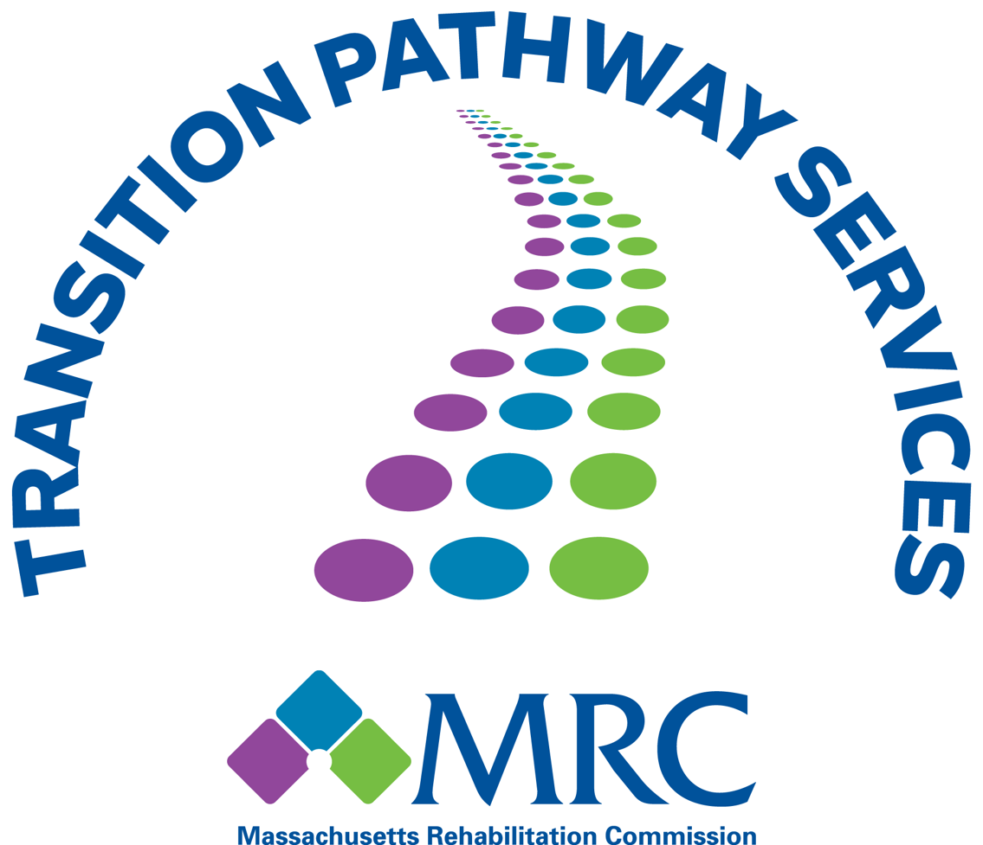
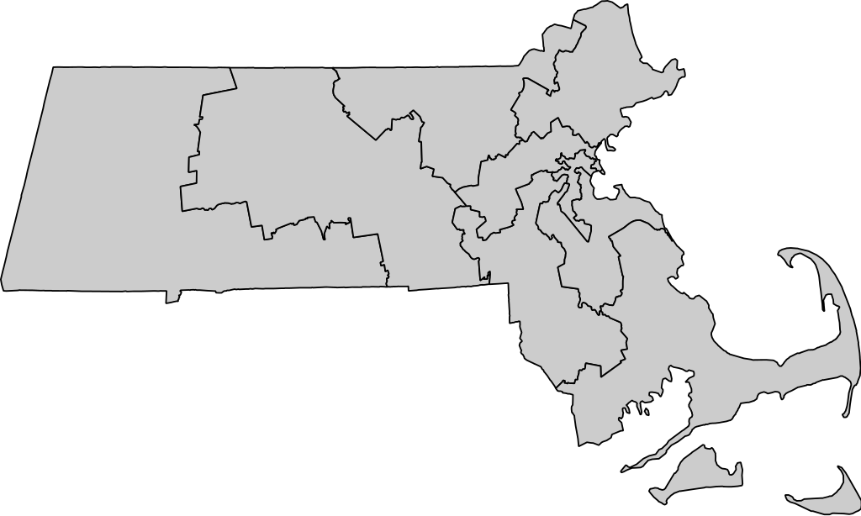
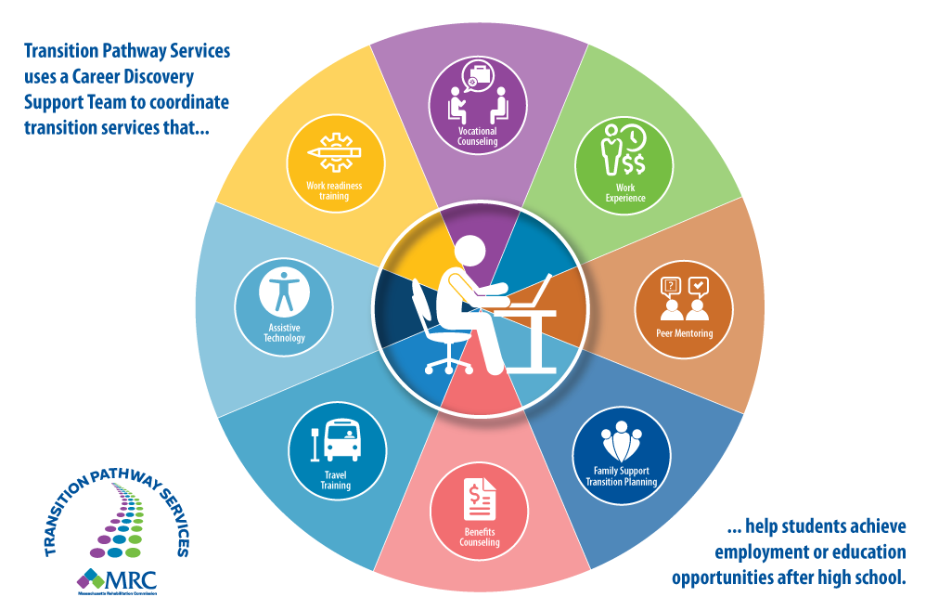
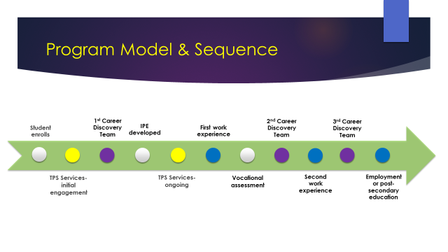
Transition Pathway Services Demonstration Grant
Massachusetts Rehabilitation Commission
Introduction
Lawrence
Massachusetts Rehabilitation Commission was awarded a 5 year, 5 million dollar federal grant from the Rehabilitation Services Administration in the Fall of 2016.
The Transition Pathway Services (TPS) Demonstration Grant develops a coordinated set of services provided by community partners including vocational rehabilitation, career centers, independent living centers, pre-employment transition vendors and local educational authorities to increase employment and/or post-secondary education opportunity for students with disabilities.
Springfield
Roxbury
Theory of Change
Transition Pathway Services believes if students have access to a coordinated Career Discovery Team of transition services that this can improve academic and career planning along with skill development that will lead to improvements in employment outcomes and postsecondary educational opportunities. The field of transition can be fragmented and redundant, through TPS efforts, students will have a more seamless transition planning process preparing them for life after high school.
Career Discovery Team Strategy
The ten services components in the TPS model include:
2 Work Based Learning Experiences
Vocational Counseling
Workplace Readiness Training
Benefits Counseling
Assistive Technology
Transportation Coordination
Vocational Assessments
Peer Mentoring
Customized Job Placement
Family Support Transition Planning.
Project Goals
Next Steps
Strengthen relationships with employers to support work readiness training and opportunities
Explore how the Career Discovery Team reduces barriers to services and information
Document promising practices around engaging students in vocational rehabilitation and work based learning
Develop trainings, guidance, and tools for all MRC Counselors working with students
Strategize about sustainability

